Slide 1
Getting the Most Out of JewishGen
Navigate
Communicate
Research Your Towns

Slide 2
Our Mission: Preserving our History for Future Generations
Not- for-Profit Internet-Based founded in 1987 by Susan King
Part of the Museum of Jewish Heritage NYC
400,000 World Wide Registrants
Staff: 3 Paid Employees, over 800 Volunteers
Notes:
Mission is to Preserve our History for Future Generations. JG is the premier instn providing internet based information connecting jewish heritage and family history. Provides a unique electronic framework which allows and encourages online researchers to gather, document and preserve our heritage.
Thru JG this info is easily accessible, in database form, available worldwide…AS A PUBLIC SERVICE.
From here…you can get most anywhere (jewish)

Slide 3
How to Navigate JewishGen

Slide 4
Everything You Want to Find… ………is on the Home Page

Slide 5
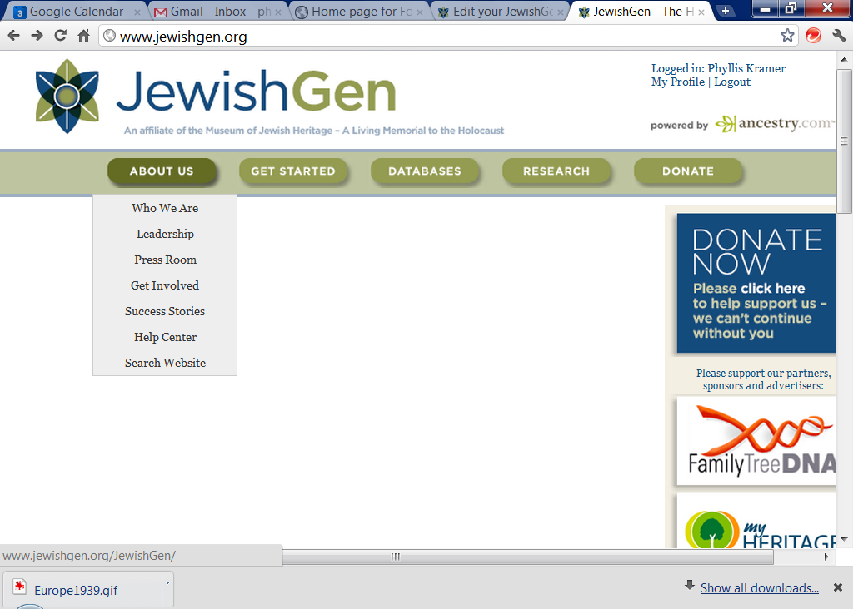
Log In!
Notes:
Click on complete list of databases…

Slide 6
My Profile (upper right corner)

Slide 7
Everything You Want to Find… ………is on the Home Page

Slide 8
Notes:
Click on complete list of databases…

Slide 9
Get Started!

Slide 10
FirstTimer page is GREAT!

Slide 11
Screencasts: 5 Minute Videos

Slide 12
Communicate
JewishGen Family Finder
Family Tree of the Jewish People
Discussion Groups
Discussion Group Archives
Notes:
These 4 items are not on ancestry (talk ancestry)
Personal, private

Slide 13
Before You Communicate
Focus: What do You Want to Know?
(my ggf) Yitchauk>Jacob STEIN
Where was he born?
Wife’s maiden Name?
Did ggf have siblings?

Slide 14
Before You Communicate
Focus: What Do You Know?
Amass family stories
Focus on the immigrants
Find the Birth towns
Get Census….
Get Vital Records…
Get Tombstones…HebrewNames
Get Manifests

Slide 15
Before You Communicate
Focus: Make Descendent Tree
(my ggf) Schulum
(my ggf) Yitchauk>Jacob STEIN
Born c. 1870 ? Russia
Married c 1890 ? Russia Eva ?
Emigrated 1902? NY
Died Dec 6, 1952 Bklyn NY
(my gf) Harold STEIN b 1907 NY

Slide 16
Start with the Database Oval

Slide 17
Notes:
Click on complete list of databases…

Slide 18
JewishGen Databases
Notes:
Start with JewishGen Researcher Databases
FF-
Two clicks and you are at the databases…

Slide 19
Communicate: JGFF JewishGen Family Finder
100,000+ Genners
500,000+ Surnames & Towns
Are Your Surnames Listed???
Notes:
FF database of people like you….
Stand up and tell us the surnames and shtetls you are researching…
Don’t just get to tell the 80+ people in this room…but 300,000 around the world…(and those who havent signed in yet!)
FF began as email search program, transferred to web in 1994.
Contains over 90,000 researchers
FTJP: launced in 1999, searchable compilation of Jewish family trees…boasts 3+million records from over 4000 submitters.
Privacy:

Slide 20
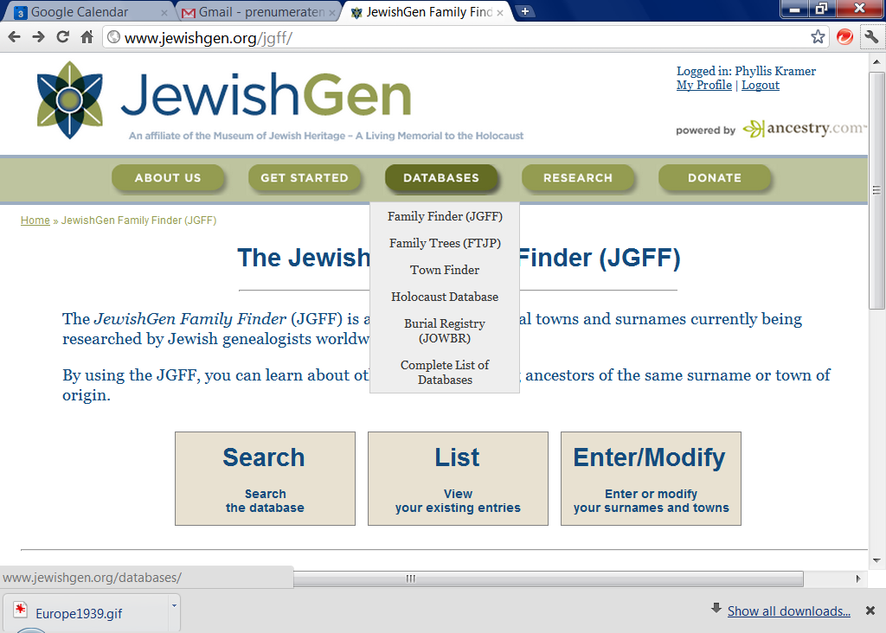
JewishGen Family Finder

Slide 23
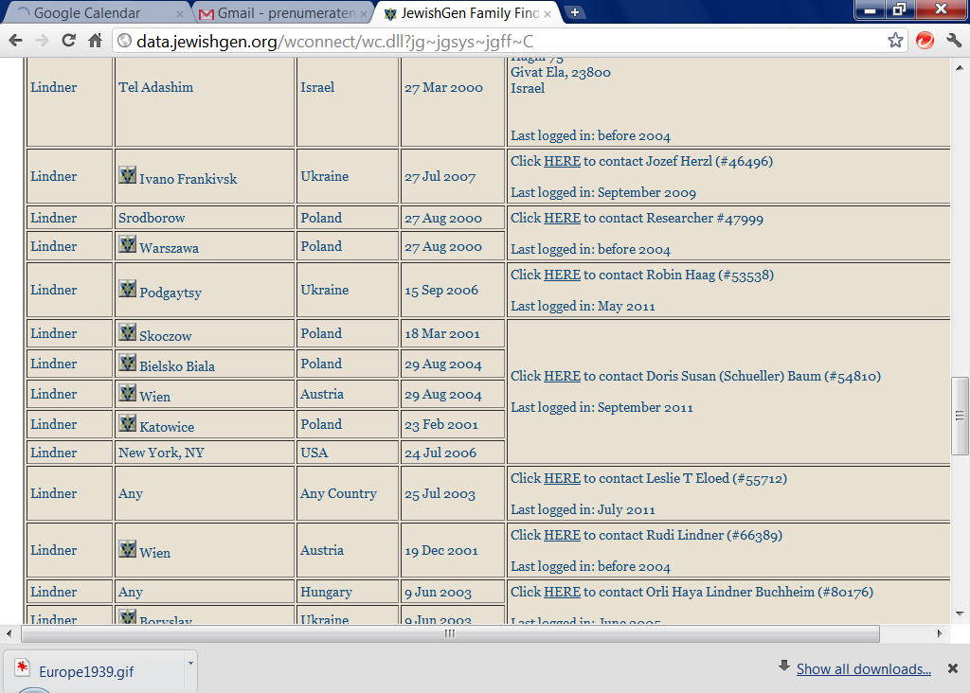
LINDNERS on JGFF

Slide 24
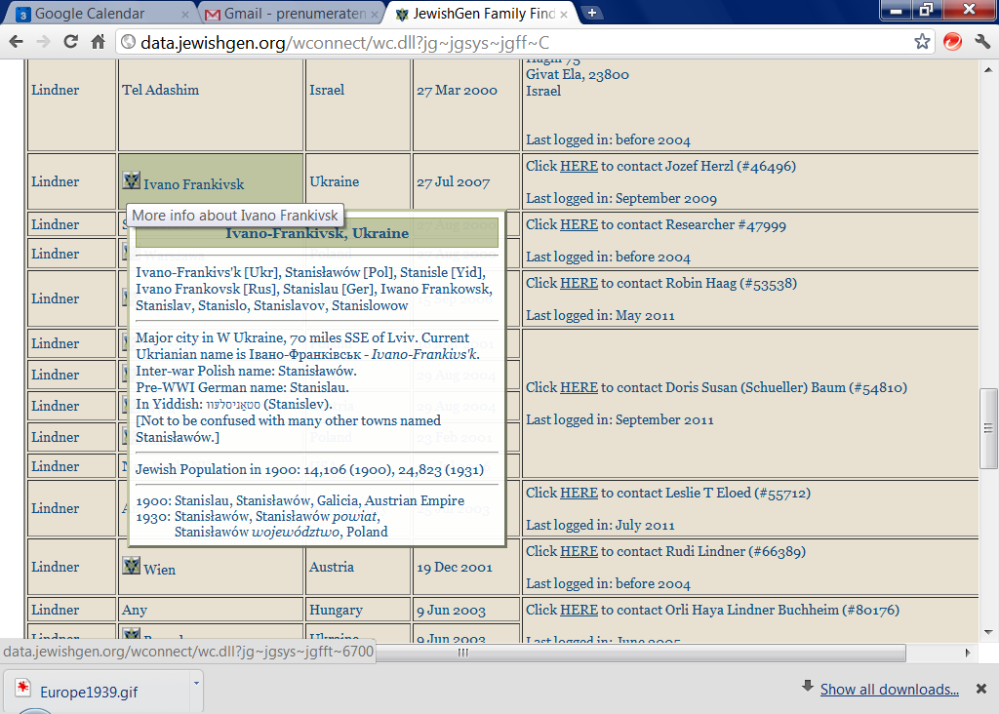
LINDNERS on JGFF

Slide 25
JewishGen Family Finder

Slide 27
How to Add Your Name Via Your Profile
Notes:
JG website is free to use, but you must register as a user to access many of the features…such as searching the database, submitting
Information.
You;ll be asked to submit your email address and create a password; you’ll receive a JewishGen ID

Slide 28
Questions on JGFF??

Slide 29
Family Tree of the Jewish People
What is it?
How do I add my Family Tree? (GEDCOM)
How do I Research FTJP?

Slide 30
Communicate: FTJP Family Tree of the Jewish People
Source: Family Tree Software Programs
Who Contributed: 5000+ Genners
How Many Entries: 5.5+ million
Notes:
FF database of people like you….
Stand up and tell us the surnames and shtetls you are researching…
Don’t just get to tell the 80+ people in this room…but 300,000 around the world…(and those who havent signed in yet!)
FF began as email search program, transferred to web in 1994.
Contains over 90,000 researchers
FTJP: launced in 1999, searchable compilation of Jewish family trees…boasts 3+million records from over 4000 submitters.
Privacy:

Slide 33
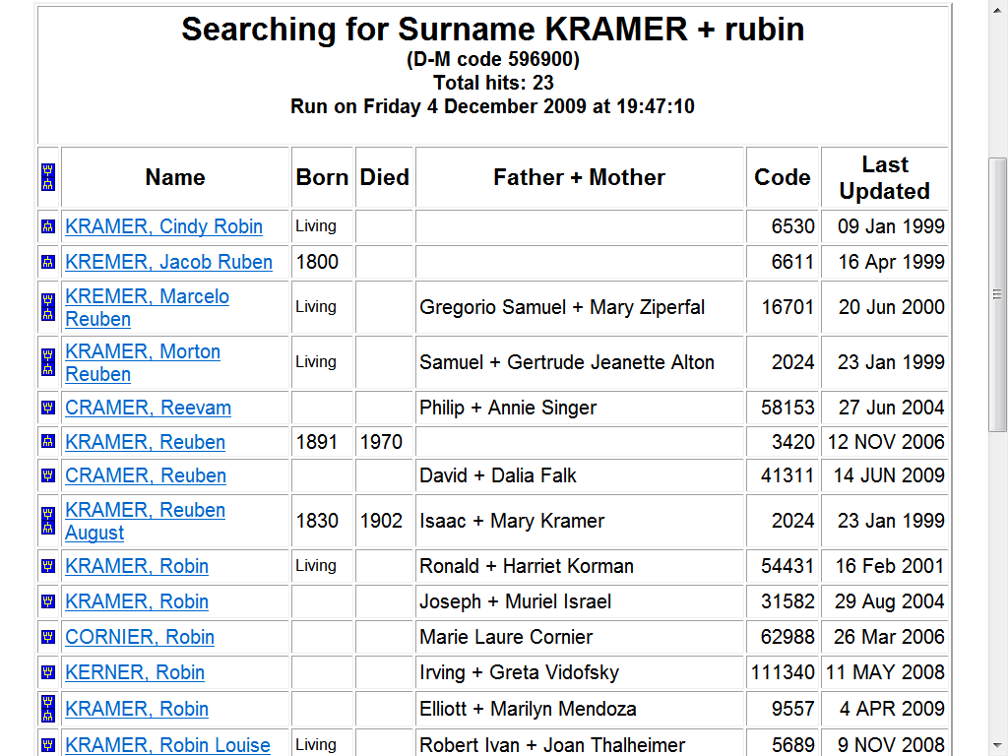

Slide 34
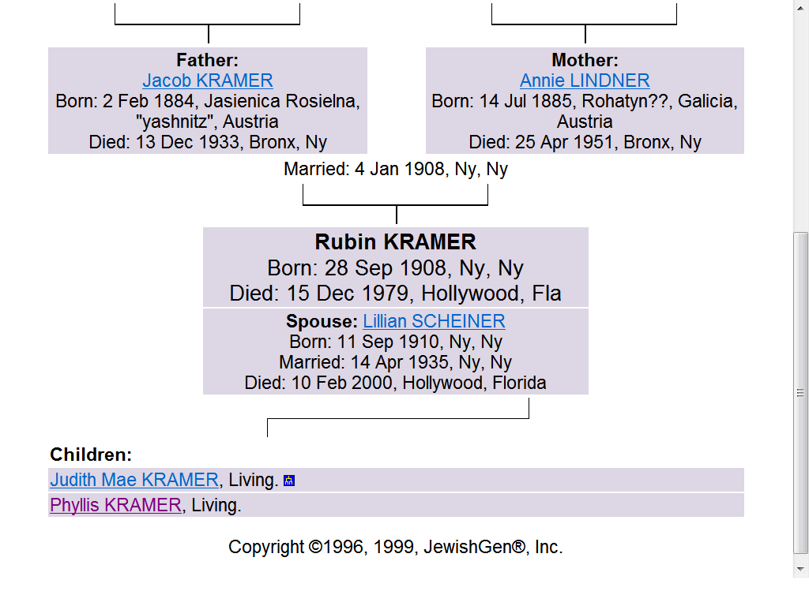
Results of FTJP Query
Notes:
This is a family tree of the person you clicked on
Notice 2 generations of ancestors are displayed…but you can now click on any name and see the tree for that person

Slide 35
My Profile (upper right corner)

Slide 36
Questions on Family Tree of the Jewish People??

Slide 37
Discussion Groups
What are they?
How Do I Subscribe?
Post a Message?
Post an Image (Viewmate) ?
Use the Archives?

Slide 38
JewishGen Discussion Groups
Online Bulletin Boards
Daily Questions, Findings, New Resources
Pointers to Photos & Documents
Notes:
Facilitate exchange among researchers…
Ourmany projects enable users to share their knowledge and resources with each other
Start with our Forum—allowing members to shrae information, ideas, methods, tips,
SHOW HOW TO SUBSCRIBE….????????????

Slide 39
Create Your Message
Moderators’ Rules:
Must be in “plain text”
Must be genealogy
No strong criticism
Commercial Notice Allowed Only Once
Maximum 6 lines of Footer
Any ‘Genner can post to Main List (jewishgen@lyris.jewishgen.org)
Must belong to SIG to Post

Slide 40
Notes:
Not going to give you instructions on how to access…
Just click on your profile and follow directions…

Slide 41
Special Interest Groups
Austria-Czech Latvia
Belarus Poland
Courland Romania
Early American Scandinavia
French Sephardic
Galicia S. Africa
German Ukraine
Hungary U. Kingdom
Notes:
About 25 SIGS…Each one has a website and a discussion list
Also discussion lists for research groups, area groups (like bialystok) 2008 conference, yizkor, DNA etc

Slide 42
How Will You Know Which Discussion Groups You are Registerred on??

Slide 43
JewishGen & Viewmate

Slide 44
Russian

Slide 46
Viewmate Steps
Scan the Document
Label and file it
Logon to JewishGen
Go to www.jewishgen.org/viewmate

Slide 47
Go to Viewmate

Slide 49
Upload Instructions

Slide 50
A Letter

Slide 51
2 Responses

Slide 52
Announce on JewishGen’s Discussion List

Slide 55
The Discussion Groups …..Archives
20+ Years of Messages

Slide 58
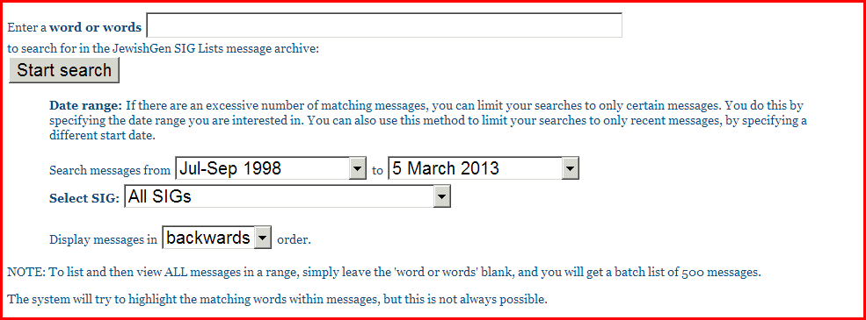

Slide 61
JewishGen Databases
Notes:
Start with JewishGen Researcher Databases
FF-
Two clicks and you are at the databases…

Slide 63
Where Do You Go From Here ?
Plan
Research
Communicate
Read & Study

Slide 64
Educate Yourself
FAQ Frequently Asked Questions
Info Files
Basics-Immigration, Libraries, Military
Info Files By Country
Special Interest Groups
OnLine Courses
Notes:
Might begin with the Frequently Asked Questions…really an intro to Jewish Genealogy
That’s me…I give basic course 3 times/year…emphasis on Internet…probably a thousand tested links…
Also one intermediate course…for graduates of basic course
Course on Shtetlinks
Hoping to have a course on European Genealogy
Courses are textual…but there’s a bulletin board for your q&a

Slide 65
Questions?

